Slide 1

Operating Systems Design 19CS2106S Session-8 File System Calls

Slide 2
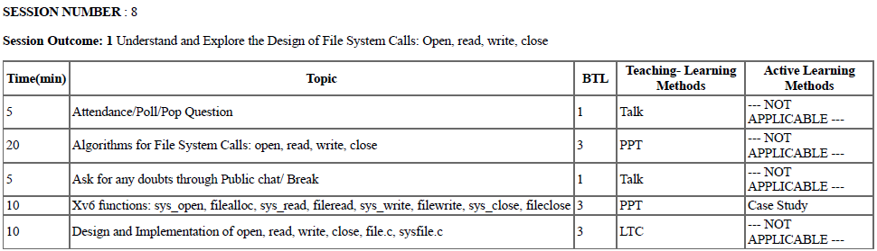
Session Plan

Slide 3
Learning Outcomes
To understand open ( ), read ( ), write ( ) and close ( ) systems calls.
To explore the above system calls in xv6 as case study.
To understand the design and implementation of sysfile.c

Slide 4
Basic Operations on Files
Opening Files
Reading and Writing Files
Closing Files
All the above operations can be implemented using Open ( ), Read ( ), Write( ), Close ( ) File System Calls

Slide 5
Review of basic terminology with Files
File Descriptor
Concept of inode
inode table
File Table

Slide 6
Lets start with File Descriptor
A file descriptor is just an integer, private per process, and is used in UNIX systems to access files.
It is dynamically generated by the kernel when you call open( ) system call (or certain other system calls).
When a file is opened, the file descriptor is used to read or write the file assuming you have permission to do so.
The descriptor is identified by a unique non-negative integer, such as 0, 12, or 567.
At least one file descriptor exists for every open file on the system

Slide 7
The first three user file descriptors (0, 1, and 2) are called the standard input, standard output, and standard error file descriptors.
Processes on UNIX systems conventionally use the standard input descriptor to read input data, the standard output descriptor to write output data, and the standard error descriptor to write error data (messages).

Slide 8
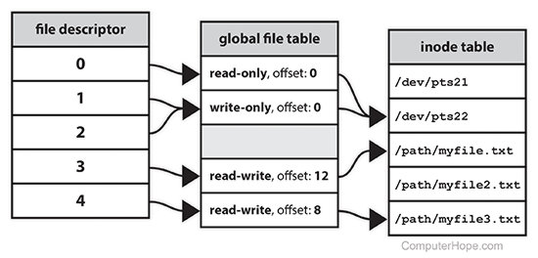

Slide 9
When a process makes a successful request to open a file, the kernel returns a number(file descriptor) which points to an entry in the kernel's global file table.
The file table entry contains information such as the inode of the file, byte offset, and the access restrictions for that data stream (read-only, write-only
Byte offset is the number of bytes from the beginning of the file.
Read and write operations normally start at the current offset and cause the offset to be incremented the number of bytes read or written, etc.).

Slide 10
Syntax
fd =open(pathname, flags, modes);
Or
int fd = open(pathname , flags , modes);

Slide 11
Here
pathname is a file name, flags indicate the type of open (such as for reading or writing), and modes give the file permissions if the file is being created.

Slide 12
open ( ) file system Call
The open system call is the first step a process must take to access the data in a file.
The syntax for the open system call is
fd =open(pathname, flags, modes);
Here pathname is a file name, flags indicate the type of open (such as for reading or writing), and modes give the file permissions if the file is being created.

Slide 13
Algorithmic Design-open ( ) file system call

Slide 14
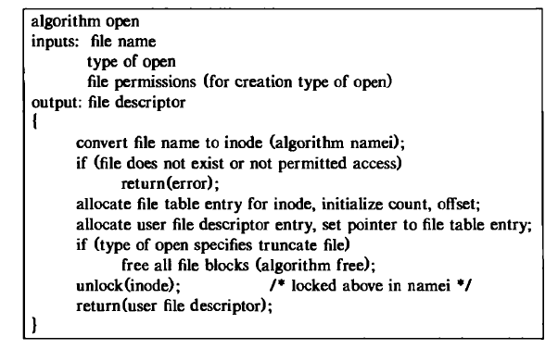
Algorithmic Design for open ( ) system call

Slide 15
The kernel searches the file system for the file name parameter using algorithm namei .
It checks permissions for opening the file after it finds the in-core mode and allocates an entry in the file table for the open file.
The file table entry contains a pointer to the mode of the open file and a field that indicates the byte offset in the file where the kernel expects the next read or write to begin.
The kernel initializes the offset to 0 during the open call, meaning that the initial read or write starts at the beginning of a file by default

Slide 16
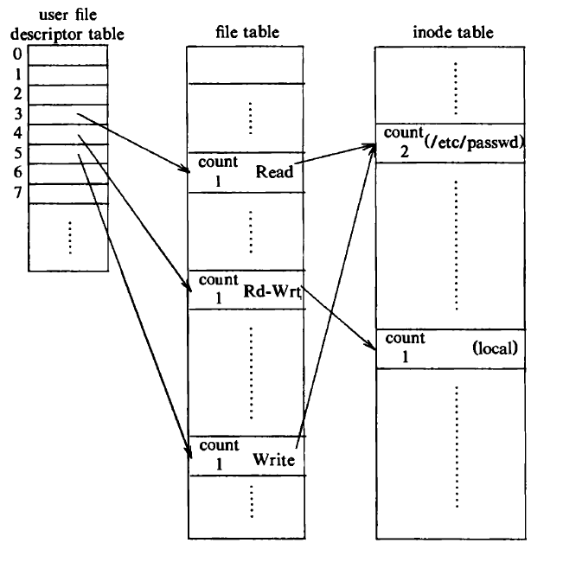
Data Structures after Open

Slide 17
Suppose a process executes the following code, opening the file letc/passwd“ twice, once read-only and once write-only, and the file "local" once, for reading and writing.
fdl = open(letc/passwd", O_RDONLY);
fd2 = open("local", 0 RDWR);
fd3 = open(letc/passwd", O_WRONLY);

Slide 18
Here, each open returns a file descriptor to the process, and the corresponding entry in the user file descriptor table points to a unique entry in the kernel file table even though one file ("/etc/passwd") is opened twice.
The file table entries of all instances of an open file point to one entry in the in-core mode table.

Slide 19
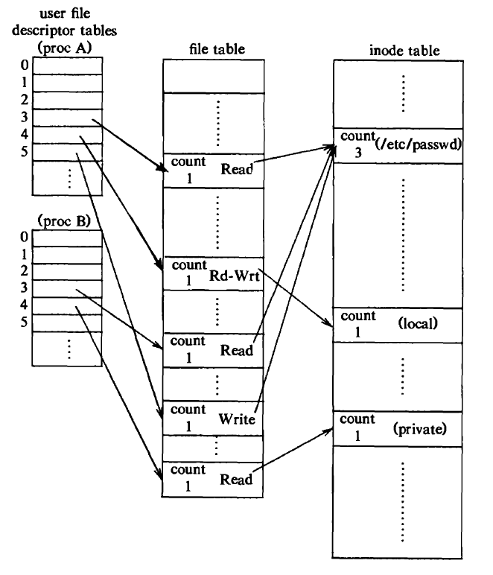
Data Structures after TWO Processes opens a File

Slide 20
read ( ) File System Call
The syntax of the read system call is
number = read(fd, buffer, count)
where
fd is the file descriptor returned by open
buffer is the address of a data structure in the user process that will contain the read data on successful completion of the call
count is the number of bytes the user wants to read, and number is the number of bytes actually read.

Slide 21
Algorithmic Design for read ( ) system call

Slide 22
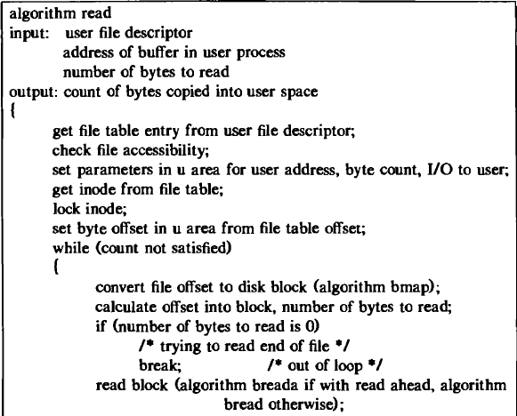
Algorithm for reading a file ( )

Slide 23
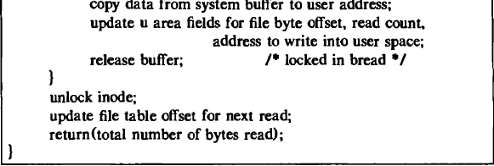
Contd…..

Slide 24
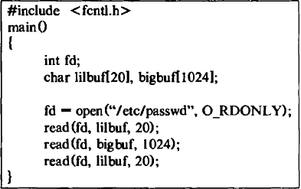
Sample Program for reading a File

Slide 25
write ( ) system call
Syntax :
number = write(fd, buffer, count);
where the meaning of the variables fd, buffer, count, and number are the same as they are for the read system call

Slide 26
close ( ) system call
Syntax:
close (fd);
where fd is the file descriptor for the open file.
The kernel does the close operation by manipulating the file descriptor and the corresponding file table and mode table entries.

Slide 27
When the close system call completes, the user file descriptor table entry is empty.
Attempts by the process to use that file descriptor result in an error until the file descriptor is reassigned as a result of another system call.
When a process exits, the kernel examines its active user file descriptors and internally closes each one.
Hence, no process can keep a file open after it terminates.

Slide 29
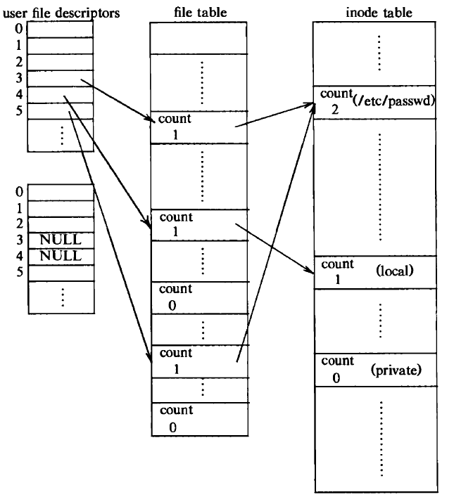

Slide 30
The entries for file descriptors 3 and 4 in the user file descriptor table are empty.
The count fields of the file table entries are now 0, and the entries are empty.
The mode reference count for the files "ietc/passwd" and "private" are also decremented.
The mode entry for "private“ is on the free list because its reference count is 0, but its entry is not empty.

Slide 31
xv6 Case Study
sys_open
filealloc
sys_read, fileread
sys_write, filewrite
sys_close, fileclose

Slide 32
Design and Implementation of sysfile.c
Its an xv6 file that consists of functions of various file system calls.
Its available from Sheet No. 60-65 of xv6 code manual.
It contains the file related functions like sys_open, filealloc, sys_read, fileread, sys_write, filewrite, sys_close, fileclose

Slide 33
sys_open
sys_open() system call opens the specified filename, using the program associated with the corresponding file type of filename.
The behaviour of this command is the same as that of double clicking on filename in the Windows Explorer.
For example, if filename is " c:\mydata\sales.xls " and the .xls extension is associated with Microsoft Excel, sys_open("c:\mydata\sales.xls") will open Excel and load the file.

Slide 34
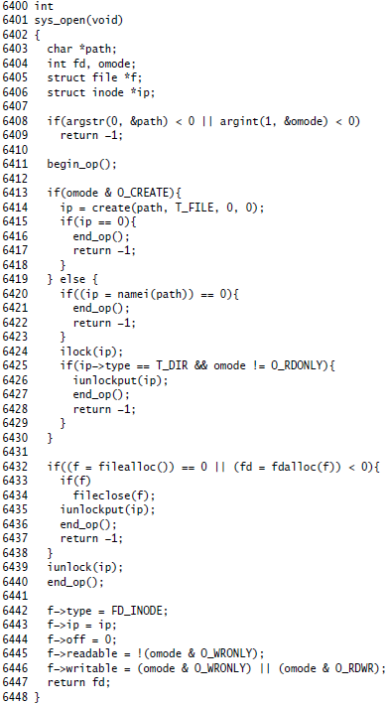
Xv6 Function of sys_open

Slide 35
filealloc
All the open files in the system are kept in a global file table, the ftable.
filealloc is a function present in file table ftable to allocate a file

Slide 36
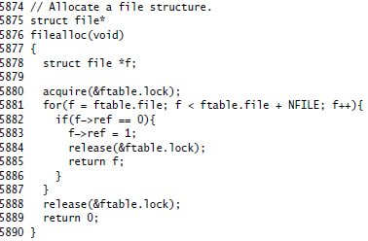
Xv6 Function of filealloc

Slide 37
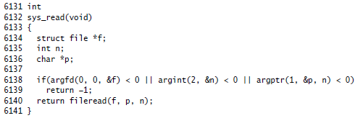
sys_read

Slide 38
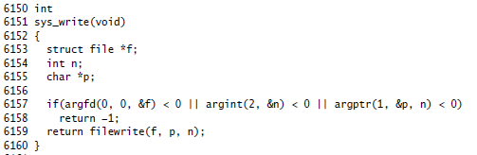
sys_write

Slide 39
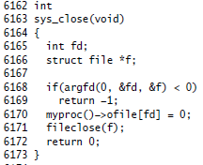
sys_close

